Slide 1



political_party_donation
View in Power BI
Last data refresh:
1/8/2023 12:19:41 PM UTC
Downloaded at:
1/8/2023 12:32:27 PM UTC

Slide 2

Home
Notes:
textbox
No alt text provided
textbox
No alt text provided
image
No alt text provided
image
No alt text provided
textbox
No alt text provided
textbox
No alt text provided
textbox
No alt text provided
image
No alt text provided

Slide 3
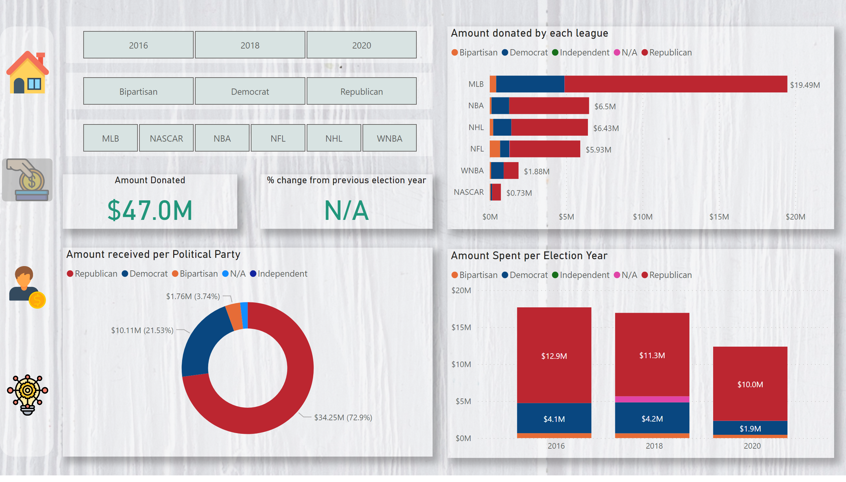
Amount Donated/Received
Notes:
slicer
No alt text provided
Amount received per Political Party
No alt text provided
slicer
No alt text provided
% change from previous election year
No alt text provided
Amount Donated
No alt text provided
Amount Spent per Election Year
No alt text provided
shape
No alt text provided
image
No alt text provided
image
No alt text provided
shape
No alt text provided
image
No alt text provided
image
No alt text provided
slicer
No alt text provided
Amount donated by each league
No alt text provided

Slide 4
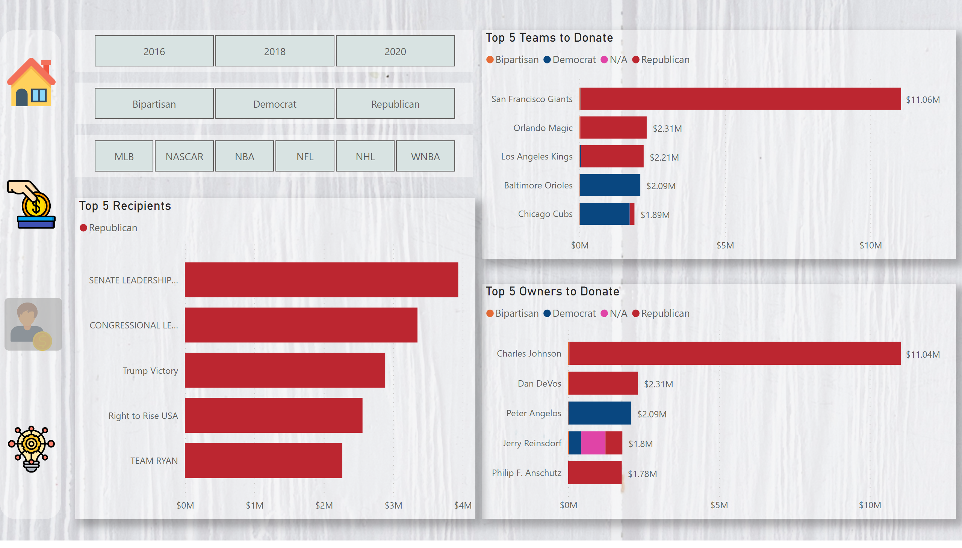
Top 5 Donors/Recipients
Notes:
shape
No alt text provided
image
No alt text provided
slicer
No alt text provided
slicer
No alt text provided
slicer
No alt text provided
Top 5 Teams to Donate
No alt text provided
Top 5 Recipients
No alt text provided
Top 5 Owners to Donate
No alt text provided
image
No alt text provided
shape
No alt text provided
image
No alt text provided
image
No alt text provided

Slide 5
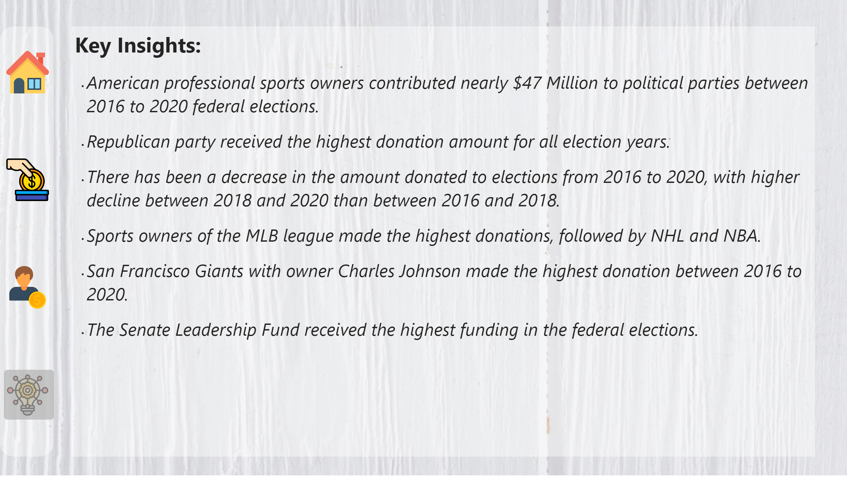
Key Insights
Notes:
textbox
No alt text provided
shape
No alt text provided
image
No alt text provided
image
No alt text provided
shape
No alt text provided
image
No alt text provided
image
No alt text provided

